Slide 1
Network Topology Exercise A V1.0
From
Routing Tables
to
Network Topology

Slide 2
Network Topology Exercise A
You need to understand the contents of the routing table to determine:
the Topology of the network
if there is a Problem with the operation of the routing protocol

Slide 3
Routing Table Entries – show ip route
The contents of the routing table:
Link local route interfaces - Added to the routing table when an interface is configured. Shows IP address of the Interface.
Connected interfaces – directly connected networks Added to the routing table when an interface is configured and active.
Static routes - Added when a route is manually configured and the exit interface is active.
Dynamic routing protocol – remote networks Added when RIP, EIGRP or OSPF are implemented and networks are identified.
Notes:
1.3.1.2 Routing Table Sources

Slide 4
Tasks
Given Routing Tables for R1, R2 and R3
Draw a Network Topology Diagram
Show all interfaces with their ip addresses
Show all LAN subnets with their subnet addresses
Show all Serial subnets with their subnet addresses
Answer Questions on the information contained in the routing tables
Notes:
2.2.1.6 Verify a Static Route

Slide 5
R1 Router - Routing Table
R1# show ip route
10.0.0.0/8 is variably subnetted, 3 subnets, 2 masks
C 10.1.1.0/30 is directly connected, Serial0/0/0
L 10.1.1.1/32 is directly connected, Serial0/0/0
R 10.2.2.0/30 [120/1] via 10.1.1.2, 00:00:21, Serial0/0/0
172.30.0.0/16 is variably subnetted, 2 subnets, 2 masks
C 172.30.10.0/24 is directly connected, FastEthernet0/1
L 172.30.10.1/32 is directly connected, FastEthernet0/1

Slide 6
R2 Router - Routing Table
R2# show ip route
10.0.0.0/8 is variably subnetted, 4 subnets, 2 masks
C 10.1.1.0/30 is directly connected, Serial0/0/0
L 10.1.1.2/32 is directly connected, Serial0/0/0
C 10.2.2.0/30 is directly connected, Serial0/0/1
L 10.2.2.2/32 is directly connected, Serial0/0/1
R 172.30.0.0/16 [120/1] via 10.2.2.1, 00:00:23, Serial0/0/1
[120/1] via 10.1.1.1, 00:00:09, Serial0/0/0
209.165.201.0/24 is variably subnetted, 2 subnets, 2 masks
C 209.165.201.0/24 is directly connected, FastEthernet0/0
L 209.165.201.1/32 is directly connected, FastEthernet0/0

Slide 7
R3 Router - Routing Table
R3# show ip route
10.0.0.0/8 is variably subnetted, 3 subnets, 2 masks
C 10.2.2.0/30 is directly connected, Serial0/0/1
L 10.2.2.1/32 is directly connected, Serial0/0/1
R 10.1.1.0/30 [120/1] via 10.2.2.2, 00:00:23, Serial0/0/1
172.30.0.0/16 is variably subnetted, 2 subnets, 2 masks
C 172.30.30.0/24 is directly connected, FastEthernet0/1
L 172.30.30.1/32 is directly connected, FastEthernet0/1

Slide 8
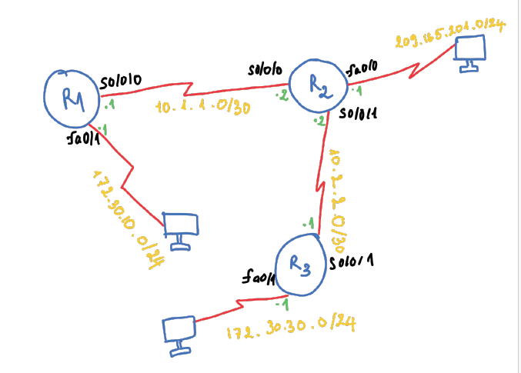
Network Topology

Slide 9
Questions
What does variably subnetted mean?
Given, from R2 routing table:
R 172.30.0.0/16 [120/1] via 10.2.2.1, 00:00:23, Serial0/0/1
[120/1] via 10.1.1.1, 00:00:09, Serial0/0/0
What does [120/1] tell Us ?
What does 00:00:23 tell Us ?
Why are RIP updates from 172.30.0.0/16 coming from two different interfaces ?
R1 cannot see 172.30.30.0/24 subnet, Why ?
R1 and R3 cannot see network 209.165.201.0/24, Why ?
Notes:
2.2.1.6 Verify a Static Route

Slide 10
What does variably subnetted mean?
Using VLSM

Slide 11
Given, from R2 routing table:
R 172.30.0.0/16 [120/1] via 10.2.2.1, 00:00:23, Serial0/0/1
[120/1] via 10.1.1.1, 00:00:09, Serial0/0/0
What does [120/1] tell Us ? 120: Administrative Distance; 1: metric (hop count) – one router between R2 and 172.30.0.0/16 network.
What does 00:00:23 tell us? Time since the route was last updated via RIP (routing table received this update 23 seconds ago).
Why are RIP updates from 172.30.0.0/16 coming from two different interfaces ? One int is next hop address to R1 subnet and one to R3 subnet. These subnets are from 172.30.0.0 /16 network

Slide 12
R1 cannot see 172.30.30.0/24 subnet, Why ?
By default, routing protocols summarise to the class level hence no subnet information is passed when an update is sent to another network.

Slide 13
R1 and R3 cannot see network 209.165.201.0/24, Why ?
R2 did not advertise this network

